Slide 2
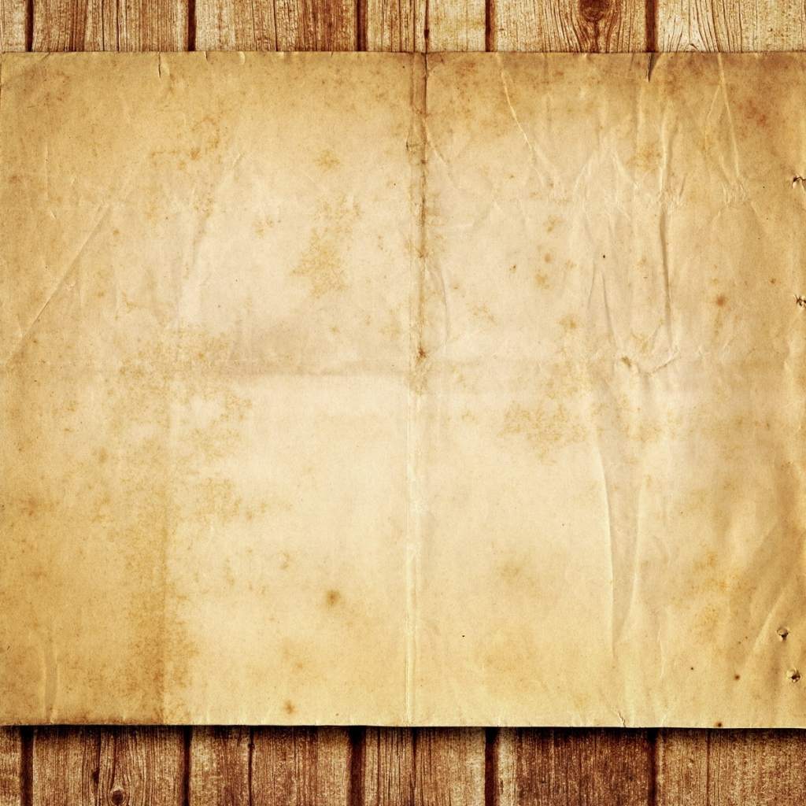
In these last days he has spoken to us by his Son, whom he appointed the heir of all things, through whom also he created the world. He is the radiance of the glory of God and the exact imprint of his nature
He is the image of the invisible God - Colossians 1:15 -

Slide 3
confidence
Our
in Jesus

Slide 4
Jesus is greater than angels
But we see him who for a little while was made lower than the angels, namely Jesus, crowned with glory and honor because of the suffering of death, so that by the grace of God he might taste death for everyone. For it was fitting that he…should make the founder of their salvation perfect through suffering. - Hebrews 2:9-10
Do not neglect the message of salvation

Slide 5
For surely it is not angels that he helps, but he helps the offspring of Abraham. Therefore he had to be made like his brothers in every respect, so that he might become a merciful and faithful high priest in the service of God, to make propitiation for the sins of the people. Hebrews 2:16-17
For because he himself has suffered when tempted, he is able to help those who are being tempted. Hebrews 2:16-17

Slide 6
Jesus is greater than Moses
Now Moses was faithful in all God's house as a servant, to testify to the things that were to be spoken later,
but Christ is faithful over God's house as a son. - Hebrews 3:5-6
Do not harden your heart and miss the rest

Slide 7
Since then we have a great high priest who has passed through the heavens, Jesus, the Son of God, let us hold fast our confession. For we do not have a high priest who is unable to sympathize with our weaknesses, but one who in every respect has been tempted as we are, yet without sin.
Hebrews 4:14-15
Let us then with confidence draw near to the throne of grace, that we may receive mercy and find grace to help in time of need. Hebrews 4:16

Slide 8
Jesus is greater than Melchizedek
This makes Jesus the guarantor of a better covenant. The former priests were many in number, because they were prevented by death from continuing in office, but he holds his priesthood permanently, because he continues forever. Consequently, he is able to save to the uttermost those who draw near to God through him, since he always lives to make intercession for them. - Hebrews 7:22-25
Do not get stuck in veiled doctrines

Slide 9
It was fitting that we should have such a high priest, holy, innocent, unstained, separated from sinners, and exalted above the heavens. He has no need, like those high priests, to offer sacrifices daily, first for his own sins and then for those of the people, since he did this once for all when he offered up himself.
Hebrews 7:26-27

Slide 10
When Christ appeared as a high priest …he entered once for all into the holy places, not by means of the blood of goats and calves but by means of his own blood, thus securing an eternal redemption. For if the blood of goats and bulls…sanctify for the purification of the flesh, how much more will the blood of Christ, who through the eternal Spirit offered himself without blemish to God.
Therefore he is the mediator of a new covenant.
Hebrews 9:11-15

Slide 11
Therefore, since we have confidence
to enter the holy places by the blood of Jesus,
by the new and living way that he opened for us
through the curtain, that is, through his flesh,
and since we have a great priest over the house of God,
let us draw near with a true heart in full assurance of faith, with our hearts sprinkled clean from an evil conscience
and our bodies washed with pure water.
Hebrews 10:19-22

Slide 12
faith
Our
in Jesus

Slide 13
The EXAMPLES of faith
Now faith is the assurance of things hoped for,
the conviction of things not seen. - Hebrews 11:1
And without faith it is impossible to please him, for whoever would draw near to God must believe that he exists and that he rewards those who seek him. - Hebrews 11:6

Slide 14
The FOCUS of faith
Therefore, since we are surrounded by so great a cloud of witnesses, let us also lay aside every weight, and sin which clings so closely, and let us run with endurance the race that is set before us, looking to Jesus, the founder and perfecter of our faith, who for the joy that was set before him endured the cross, despising the shame, and is seated at the right hand of the throne of God. Consider him who endured from sinners such hostility against himself, so that you may not grow weary or fainthearted.
- Hebrews 12:1-3

Slide 15
The ENDURANCE of faith
In your struggle against sin you have not yet resisted to the point of shedding your blood. … It is for discipline that you have to endure. God is treating you as sons/daughters. … For the moment all discipline seems painful rather than pleasant, but later it yields the peaceful fruit of righteousness to those who have been trained by it.
- Hebrews 12:4-11

Slide 16
The ENDURANCE of faith
Therefore lift your drooping hands and strengthen your weak knees, and make straight paths for your feet, so that what is lame may not be put out of joint but rather be healed. Strive for peace with everyone, and for the holiness without which no one will see the Lord. See to it that no one fails to obtain the grace of God.
- Hebrews 12:12-17

Slide 17
The HOME of faith
You have come to Mount Zion and to the city of the living God, the heavenly Jerusalem, and to innumerable angels in festal gathering, and to the assembly of the firstborn who are enrolled in heaven, and to God, the judge of all, and to the spirits of the righteous made perfect, and to Jesus, the mediator of a new covenant, and to the sprinkled blood that speaks a better word than the blood of Abel. See that you do not refuse him who is speaking.
- Hebrews 12:18-29

Slide 18
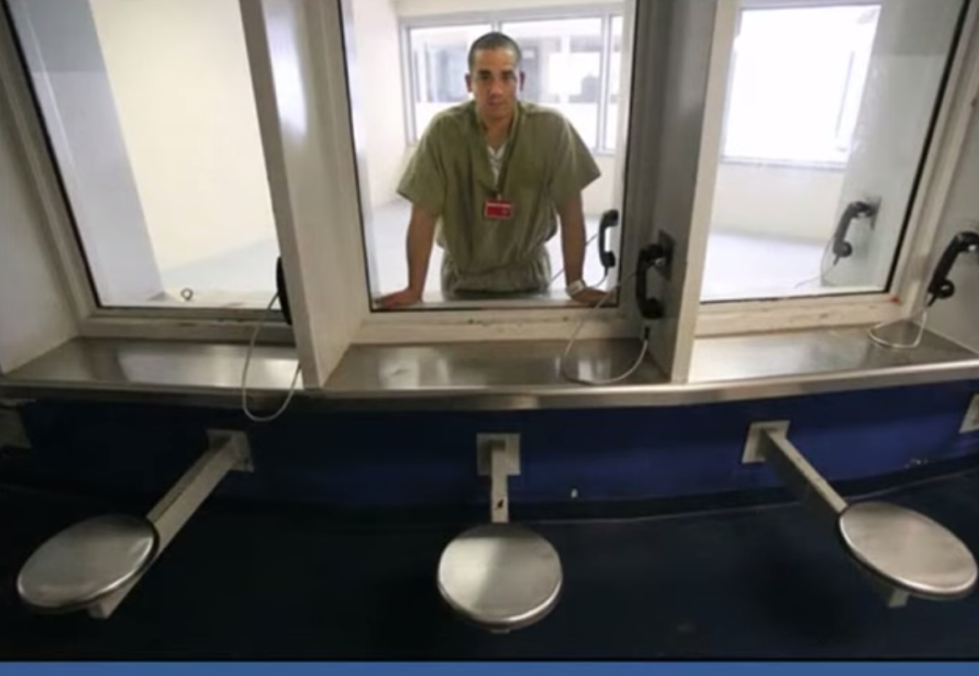
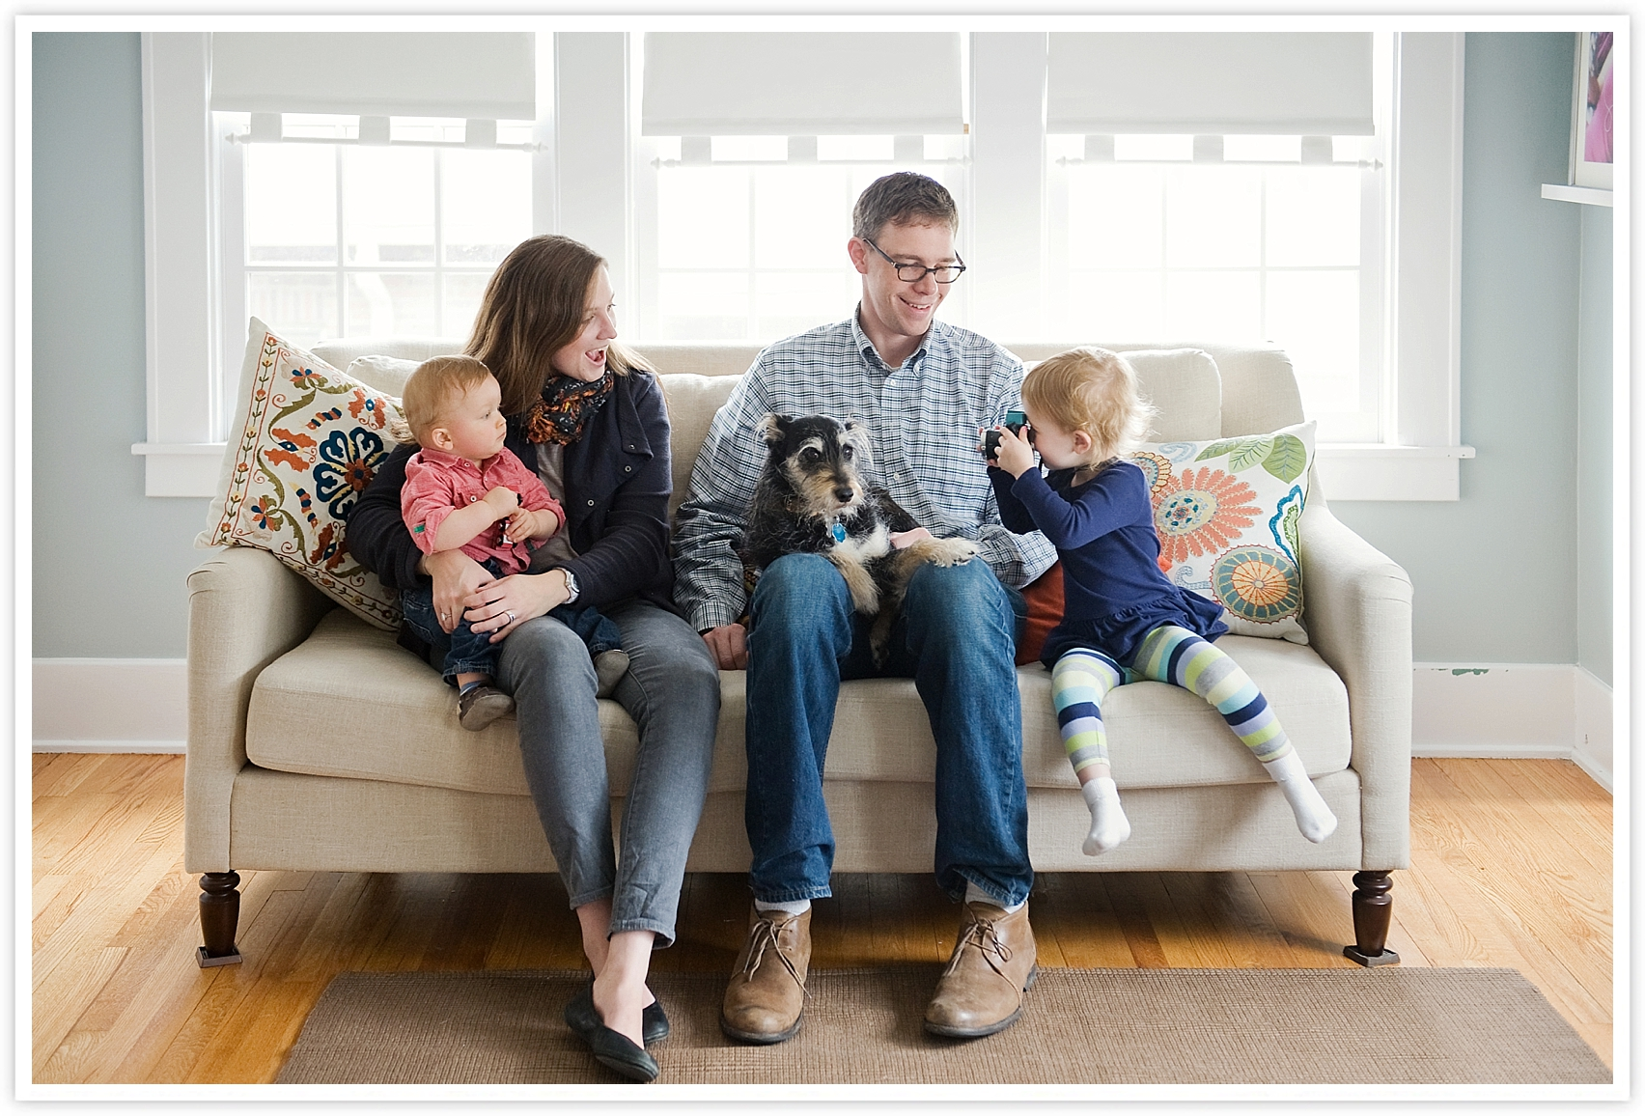
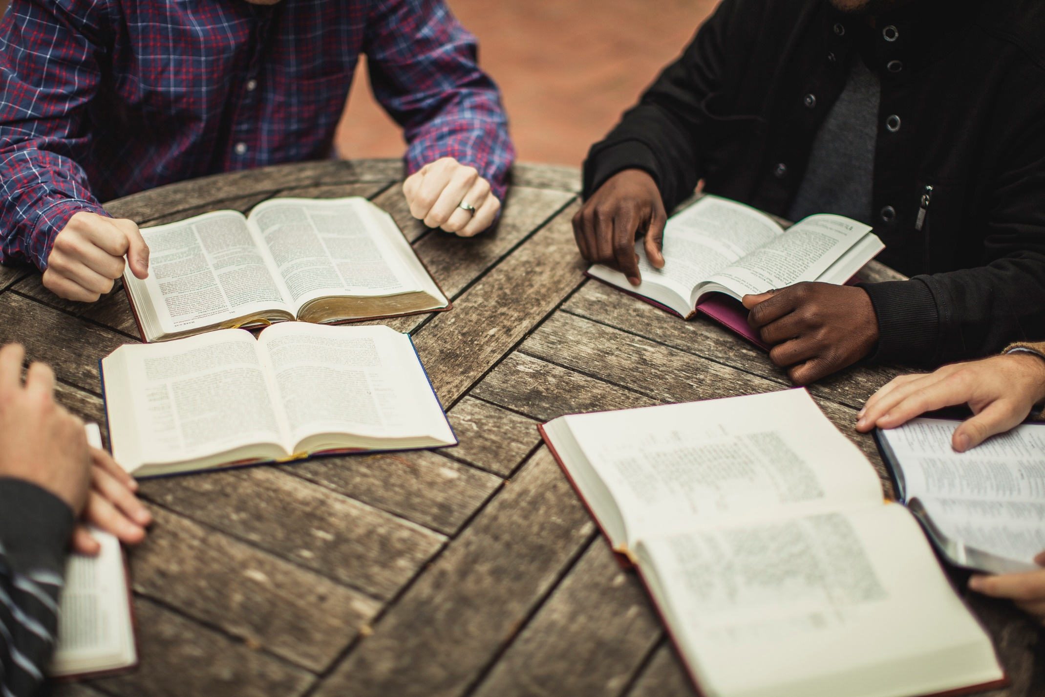
The LIFE of faith

