Slide 1
THE ST RY
66

Slide 2
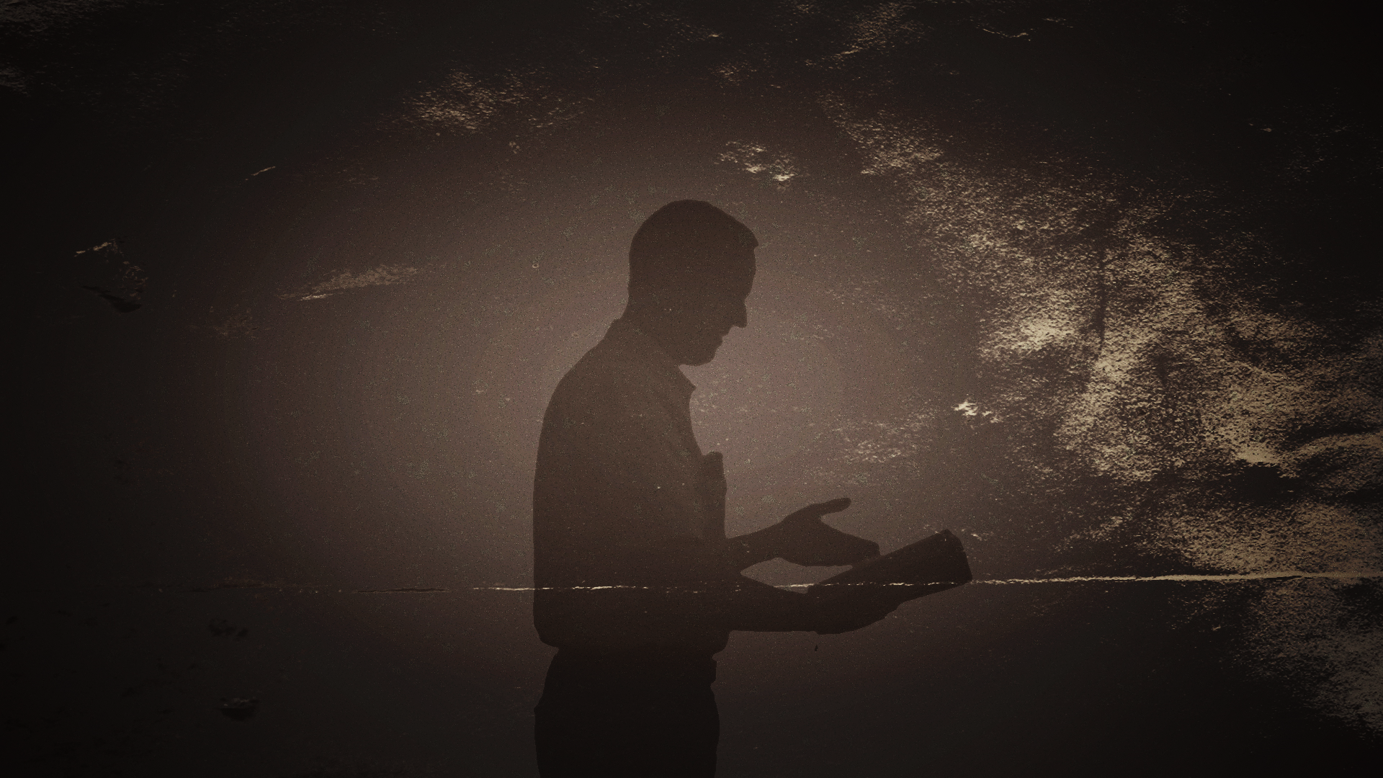
Paul came to Derbe and to Lystra. A disciple was there, named Timothy, the son of a Jewish woman who was
a believer, but his father was a Greek. He was well spoken of by the
brothers at Lystra and Iconium.
Paul wanted Timothy to
accompany him, and he took him and circumcised him because of the Jews who were in those places, for they all knew that his father was
a Greek.
I (Paul) went up again to Jerusalem … Titus, who was with me, was not forced to be circumcised, though he was a Greek.
Yet because of false brothers secretly brought in—who slipped in to spy out our freedom that we have in Christ Jesus, so that they might bring us into slavery— to them we did not yield in submission even for a moment, so that the truth of the gospel might be preserved for you.

Slide 3
Works of righteousness among the unchurched / dechurched

Slide 4
Love not Law
The aim of our charge is love that issues from a pure heart and a good conscience and a sincere faith.
1 Timothy 1:5
Works of righteousness among the unchurched / dechurched

Slide 5
Pray not Prey
I urge that supplications, prayers, intercessions, and thanksgivings be made for all people... that we may lead a peaceful and quiet life,
godly and dignified in every way.
1 Timothy 2:1-2
Works of righteousness among the unchurched / dechurched

Slide 6
Pursue righteousness
Train yourself for godliness… Let no one despise you for your youth, but set the believers an example in speech, in conduct, in love, in faith, in purity.
1 Timothy 4:7, 12
Works of righteousness among the unchurched / dechurched

Slide 7
Pursue righteousness
Pursue righteousness, godliness, faith, love, steadfastness, gentleness. Fight the good fight of the faith. Take hold of the eternal life to which you were called and about which you made the good confession in the presence of many witnesses.
1 Timothy 6:11-12
Works of righteousness among the unchurched / dechurched

Slide 8
Pursue righteousness
Flee youthful passions and pursue righteousness, faith, love, and peace, along with those who call on the Lord from a pure heart.
2 Timothy 2:22
Works of righteousness among the unchurched / dechurched

Slide 9
Love. Pray. Pursue.
This is good, and it is pleasing in the sight of God our Savior, who desires all people to be saved and to come to the knowledge of the truth. For there is one God, and there is one mediator between God and men, the man Christ Jesus, who gave himself as a ransom for all, which is the testimony given at the proper time.
1 Timothy 2:3-6
Works of righteousness among the unchurched / dechurched

Slide 10
Until I come, devote yourself to the public reading of Scripture, to exhortation, to teaching. …Practice these things, immerse yourself in them, so that all may see your progress. Keep a close watch on yourself and on the teaching. Persist in this, for by so doing you will save both yourself and your hearers.
1 Timothy 4:13-16
Works of righteousness among the unchurched / dechurched

Slide 11
The Word of righteousness among the churched

Slide 12
Do not be afraid of persecution
God gave us a spirit not of fear but of power and love and self-control.
Therefore do not be ashamed of the testimony about our Lord, nor of me his prisoner, but share in suffering for the gospel by the power of God.
2 Timothy 1:7-8
All who desire to live a godly life in Christ Jesus will be persecuted.
2 Timothy 3:12
The Word of righteousness among the churched

Slide 13
Preach in the face of churchy-godlessness
In the last days there will come times of difficulty. For people will be
lovers of self, lovers of money, proud, arrogant, abusive,
disobedient to their parents, ungrateful, unholy, heartless, unappeasable, slanderous, without self-control, brutal, not loving good, treacherous, reckless, swollen with conceit, lovers of pleasure rather than lovers of God,
having the appearance of godliness, but denying its power.
Avoid such people. 2 Timothy 3:1-5
They profess to know God, but they deny him by their works. They are detestable, disobedient, unfit for any good work. Titus 1:16
The Word of righteousness among the churched

Slide 14
Preach the Word!
All Scripture is breathed out by God and profitable for teaching, for reproof, for correction, and for training in righteousness, that the man of God may be complete, equipped for every good work.
I charge you in the presence of God and of Christ Jesus, who is to judge the living and the dead, and by his appearing and his kingdom: preach the word; be ready in season and out of season; reprove, rebuke, and exhort, with complete patience and teaching.
2 Timothy 3:16 – 4:2
The Word of righteousness among the churched

Slide 15
Teach, Reprove and Rebuke
There are many who are insubordinate, empty talkers and deceivers, especially those of the circumcision party. They must be silenced. … One of the Cretans, a prophet of their own, said, “Cretans are always liars, evil beasts, lazy gluttons.” This testimony is true.
Therefore rebuke them sharply, that they may be sound in the faith.
… They profess to know God, but they deny him by their works. They are detestable, disobedient, unfit for any good work. But as for you, teach what accords with sound doctrine.
Titus 1:10 – 2:1
Works of righteousness among the unchurched / dechurched

Slide 16
Exhort
Remind them to be submissive to rulers and authorities, to be obedient, to be ready for every good work, to speak evil of no one,
to avoid quarreling, to be gentle, and to show perfect courtesy toward all people. For we ourselves were once foolish, disobedient, led astray, slaves to various passions and pleasures, passing our days in malice and envy, hated by others and hating one another. But when the goodness and loving kindness of God our Savior appeared, he saved us, not because of works done by us in righteousness, but according to his own mercy.
Titus 3:1–6
Works of righteousness among the unchurched / dechurched

Slide 17
Do not fear. Preach.
Insist on these things,
so that those who have believed in God
may be careful to devote themselves
to good works.
Titus 3:8
Works of righteousness among the unchurched / dechurched

