Slide 3
Freedom by Faith
We know that a person is not justified by works of the law but through faith in Jesus Christ. - Galatians 2:16 -

Slide 4
Freedom from the curse of the Law
For all who rely on works of the law are under a curse; for it is written, “Cursed be everyone who does not abide by all things written in the Book of the Law, and do them.” Now it is evident that no one is justified before God by the law, for “The righteous shall live by faith.”
- Galatians 3:10-12
Christ redeemed us from the curse of the law
by becoming a curse for us.
- Galatians 3:13

Slide 5
FACT #1
We are crucified with Christ
I have been crucified with Christ. It is no longer I who live, but Christ who lives in me.
And the life I now live in the flesh I live by faith in the Son of God,
who loved me and gave Himself for me.
Galatians 2:20

Slide 6
Freedom as Family
There is neither Jew nor Greek, there is neither slave nor free,
there is no male and female, for you are all one in Christ Jesus.
And if you are Christ's, then you are Abraham's offspring,
heirs according to promise. - Galatians 3:28-29

Slide 7
Freedom from slavery
Now before faith came, we were held captive under the law, imprisoned until the coming faith would be revealed.
So then, the law was our guardian until Christ came.
- Galatians 3:23-24
But now that faith has come, we are no longer under a guardian, for in Christ Jesus you are all sons of God, through faith.
- Galatians 3:25-26

Slide 8
FACT #2
We are baptized into Christ
For as many of you as were baptized into Christ have put on Christ.
Galatians 3:27

Slide 9
We were enslaved to the elementary principles of the world. But when the fullness of time had come, God sent forth his Son, born of woman, born under the law, to redeem those who were under the law, so that we might receive adoption as sons.
And because you are sons, God has sent the Spirit of his Son into our hearts, crying, “Abba! Father!” So you are no longer a slave, but His child
… an heir through God.

Slide 10
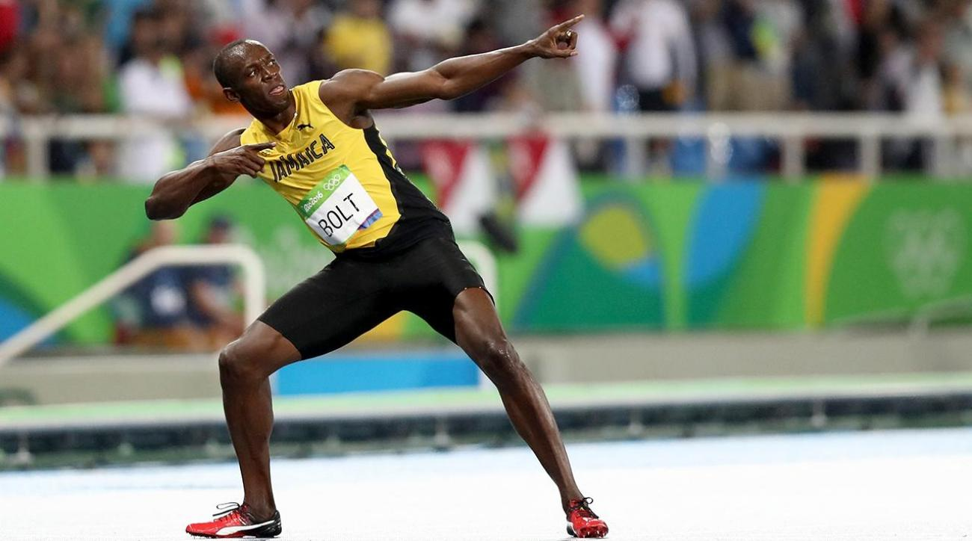
Freedom for Freedom
For freedom Christ has set us free. - Galatians 5:1

Slide 11
Freedom from the flesh
FLESHLY RELIGION
If you accept circumcision, Christ will be of no advantage to you.
I testify again to every man who accepts circumcision
that he is obligated to keep the whole law.
You are severed from Christ, you who would be justified by the law; you have fallen away from grace. For through the Spirit, by faith,
we ourselves eagerly wait for the hope of righteousness.
For in Christ Jesus neither circumcision nor uncircumcision
counts for anything, but only faith working through love.
- Galatians 5:2-6

Slide 12
Freedom from the flesh
FLESHLY RELATIONSHIPS
You were called to freedom, brothers. Only do not use your freedom as an opportunity for the flesh, but through love serve one another. For the whole law is fulfilled in one word: “You shall love your neighbor as yourself.”
- Galatians 5:13-15

Slide 13
Freedom from the flesh
FLESHLY DESIRES
Walk by the Spirit, and you will not gratify the desires of the flesh. For the desires of the flesh are against the Spirit, and the desires of the Spirit are against the flesh, for these are opposed to each other, to keep you from doing the things you want to do. But if you are led by the Spirit, you are not under the law. Now the works of the flesh are evident: sexual immorality, impurity, sensuality, idolatry, sorcery, enmity, strife, jealousy, fits of anger, rivalries, dissensions, divisions, envy, drunkenness, orgies, and things like these. I warn you, those who do such things will not inherit the kingdom of God. But the fruit of the Spirit is love, joy, peace, patience, kindness, goodness, faithfulness, gentleness, self-control; against such things there is no law.”
- Galatians 5:16-23

Slide 14
FACT #3
We boast in the cross of Christ
Far be it from me to boast except in the cross of our Lord Jesus Christ,
by which the world has been crucified to me, and I to the world.
Galatians 6:14

