Slide 2
ACTS 1:8 -
You will receive power when the Holy Spirit has come upon you, and you
will be my
witnesses in Jerusalem and in all Judea and Samaria, and to the end of the earth.
- ACTS 8:1 -
And there arose
on that day
a great persecution against
the church in Jerusalem,
and they
were all
scattered throughout
the regions
of Judea
and Samaria.

Slide 3
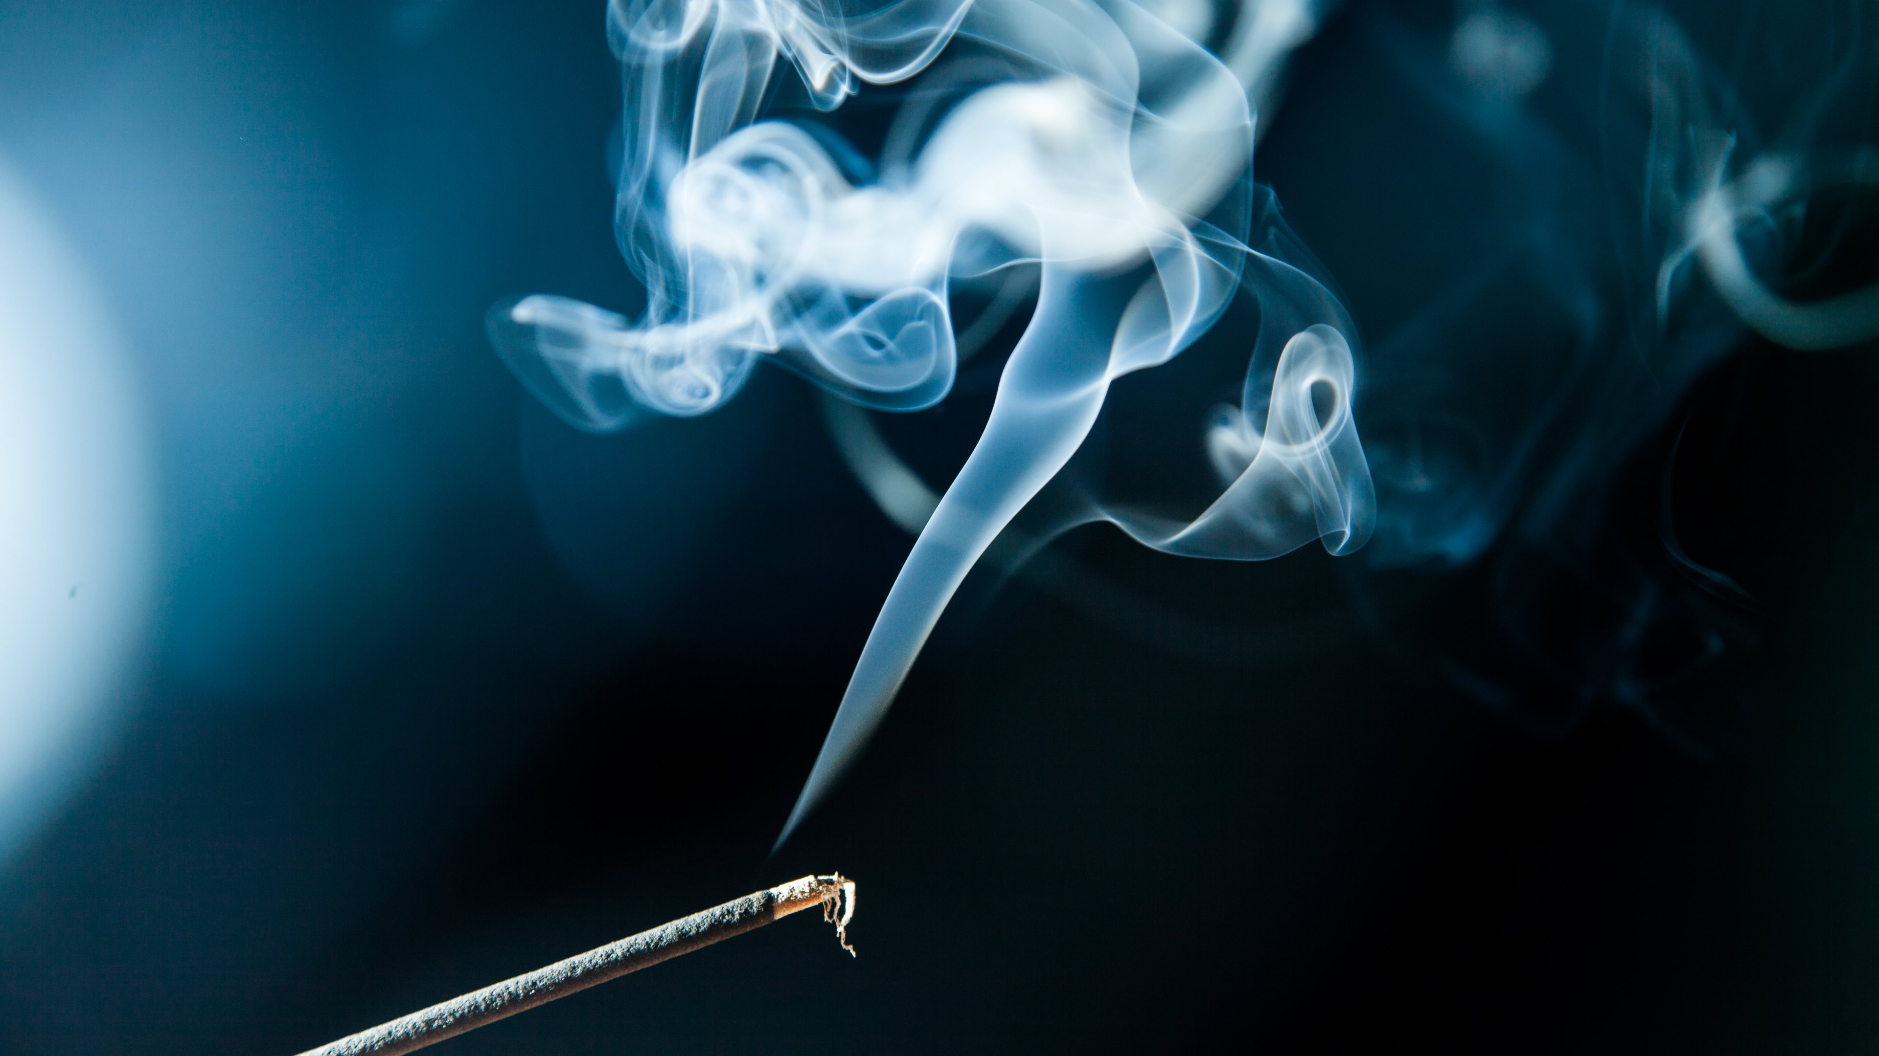
peter
Holy Spirit changed

Slide 4
powerful
The pitiful become
Peter is empowered to proclaim Jesus

Slide 5
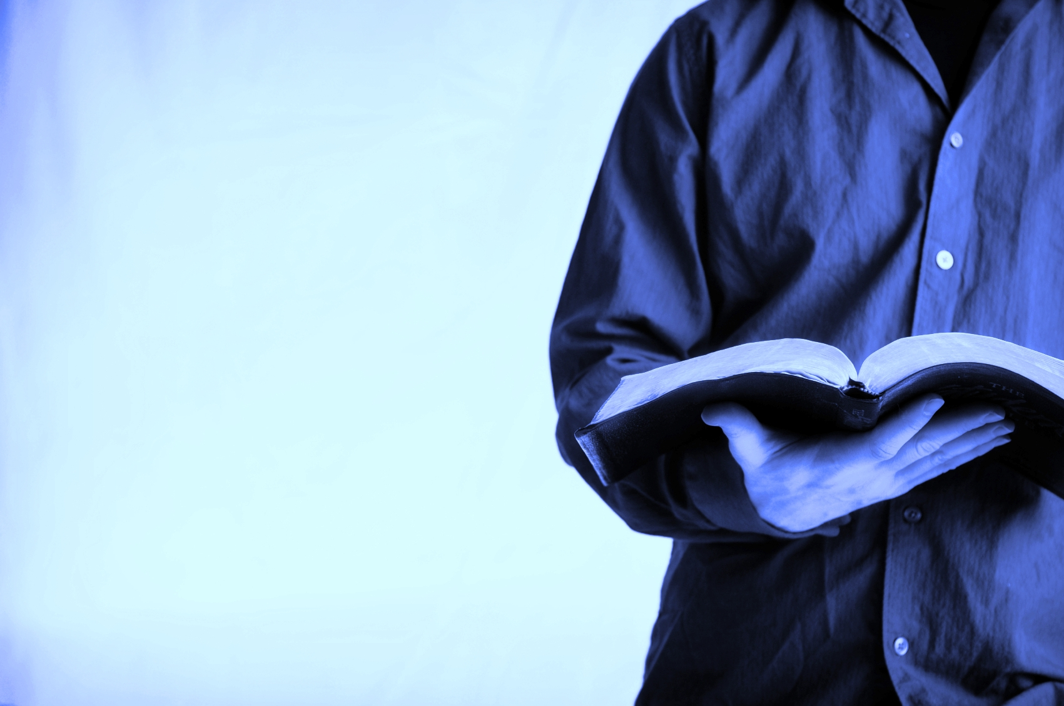
Power to proclaim Jesus…
According to the Word of God
Without fear
God gave us a spirit not of fear but of power – 2 Timothy 1:7
In the presence of persecution

Slide 6
Confessed his weakness
Received the Holy Spirit (Judges 6:34)
Obeyed the Lord
He is like a refiner’s fire and like fullers’ soap
- Malachi 3:2

Slide 7
paul
Holy Spirit changed

Slide 8
new
The old becomes
Paul is a new ambassador of Jesus

Slide 9
Sent out
Being sent out by the Holy Spirit…
Set apart
The Holy Spirit said, “Set apart for Me…”
Sight

Slide 10
Faith Community
He is transformed
Do what you do
You will meet a group of prophets coming down from the high place.
Then the Spirit of the Lord will rush upon you, and you will prophesy with them and be turned into another man. Now when these signs meet you, do what your hand finds to do, for God is with you. - 1 Samuel 10:5-7

Slide 11
you
Holy Spirit will change

Slide 12
Power to proclaim Jesus
“God chose what is foolish in the world to shame the wise; God chose what is weak in the world to shame the strong… so that
no human being might boast
in the presence of God. ... And I was with you in weakness and in fear and much trembling, and my speech and my message were not in plausible words of wisdom, but in demonstration of the Spirit and of power,
so that your faith might not rest in
the wisdom of men but in the power of God.” – 1 Corinthians 1:27-29, 2:3-5

Slide 13
New life to live for Jesus
“Do you not know that you are God's temple and that God's Spirit
dwells in you?... Let no one deceive himself. If anyone among you thinks
that he is wise in this age, let him become a fool that he may become wise.” – 1 Corinthians 3:16, 18

Slide 14
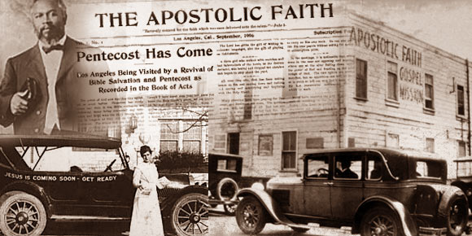
Azusa Street Revival (1906-1915)

Slide 16
“There is something higher than the new birth, namely, the entering
in of the Holy Spirit, in His fullness and glory. Jesus was born of the Spirit
in Bethlehem, but He was baptized of the Spirit thirty years later
on the banks of the Jordan; and this made all the difference for His public ministry.
And so there is in the believer's life a similar experience, when the soul that is truly converted to God yields itself wholly to His control and becomes the living temple of the Almighty Spirit, who then dwells in us, and walks in us, giving us not only a new nature, which we receive in regeneration, but a Divine Presence to dwell in that new nature
as its controlling guide and Almighty strength.
He is the very element of our new existence; before us, behind us, above us, beneath us, within us, beyond us, we are buried in Him, lost in Him, encompassed by Him as by the air we breathe.
This is the yet higher mystery of the new life, greater than the new birth."

Slide 17
do what you do
God
Is
With
you

