Slide 2
4000+
1400
930
722
539
400
1445
1405
1050
586
Exodus
Jonah
ASSYRIA
conquers
Israel
Proverbs
Esther
Obadiah
Hosea
Psalms
Judges
EXILE
Captives in Babylon
Amos
Numbers
Genesis
Joshua
Ecclesiastes
Northern Kingdom (10 Tribes): Israel
Ezra
Nehemiah
Leviticus
Southern Kingdom (2 Tribes): Judah
Ruth
Song of Songs
Micah
Isaiah
Nahum
Jer / Lam
1 & 2 Samuel
Zephaniah
Ezekiel
Haggai
Job
Joel
Habakkuk
Deuteronomy
Daniel
1 & 2 Kings
Zechariah
1 & 2 Chronicles
Egypt Assyria Babylon Medo-Persia

Slide 3
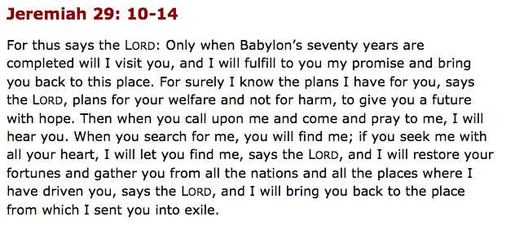
The Emphasis: Zechariah 1:3 Return to me, says the Lord of hosts, and I will return to you.

Slide 4
He is the God of

Slide 5
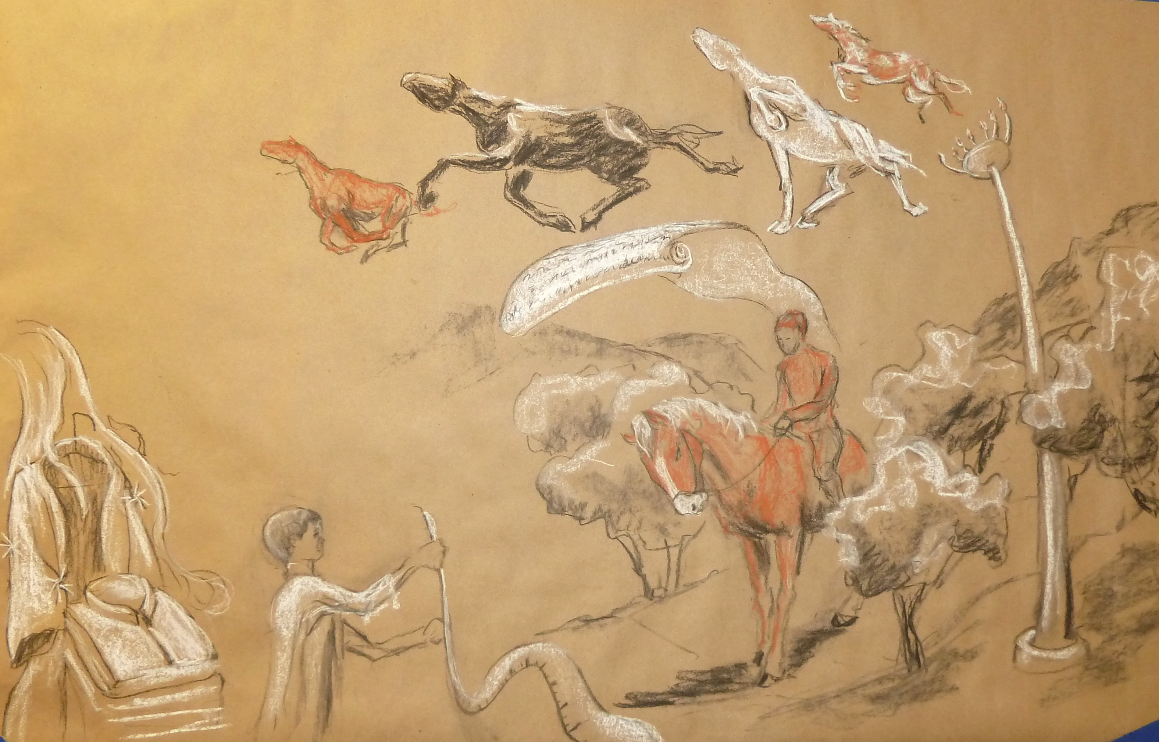
Zechariah 1-6

Slide 6
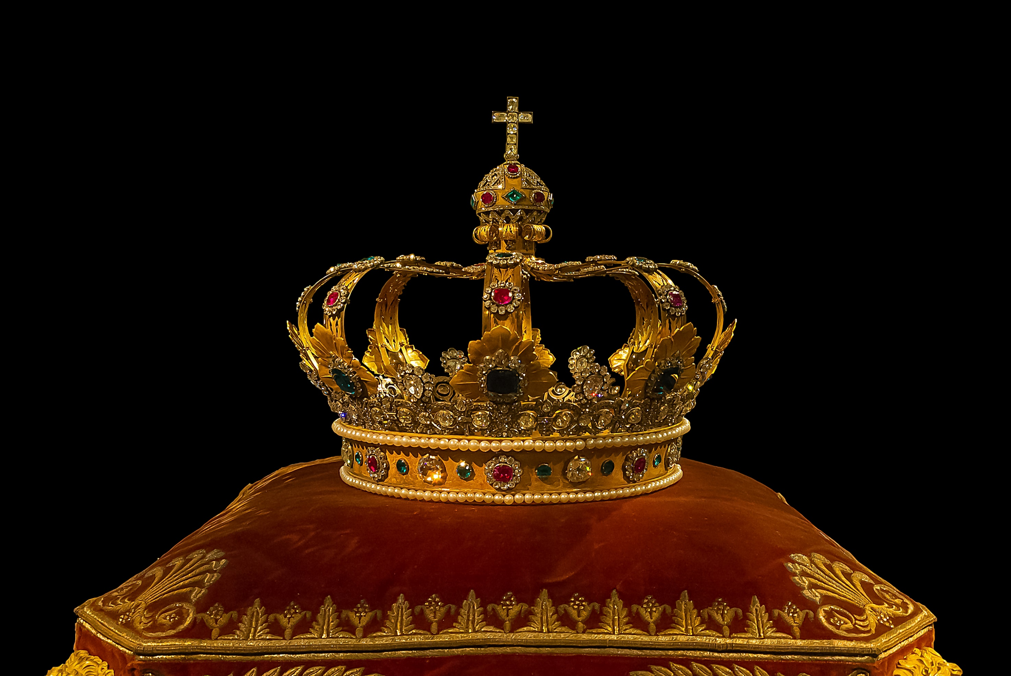
“Since we have a great high priest, Jesus, the Son of God, let us hold fast our confession. With confidence, let us draw near to the throne of grace, that we may receive mercy and find grace to help in time of need.” - Hebrews 4:14, 16
A King’s crown for a High Priest

Slide 7
[
]
He is the God of
LOVE

Slide 8
Thus says the Lord of hosts: I am jealous for Zion with great jealousy, and I am jealous for her with great wrath.
- Zechariah 8:2
God’s love is
JEALOUS

Slide 9
“By this all people will know that you are my disciples, if you have love for one another.” – John 13:35
Should be
Should be
celebrated
appealing
The fasts shall be of joy and gladness and cheerful feasts.
Zechariah 8:18-19
People from every nation will say, “Let us go with you, for we have heard that God is with you.”
Zechariah 8:23

Slide 10
[
]
He is the God of
HOPE

Slide 11
Rejoice greatly, O daughter of Zion! Shout aloud, O daughter of Jerusalem! Behold, your king is coming to you; righteous and having salvation is he, humble and mounted on a donkey, on a colt, the foal of a donkey.
Confess your duplicitous living

Slide 12
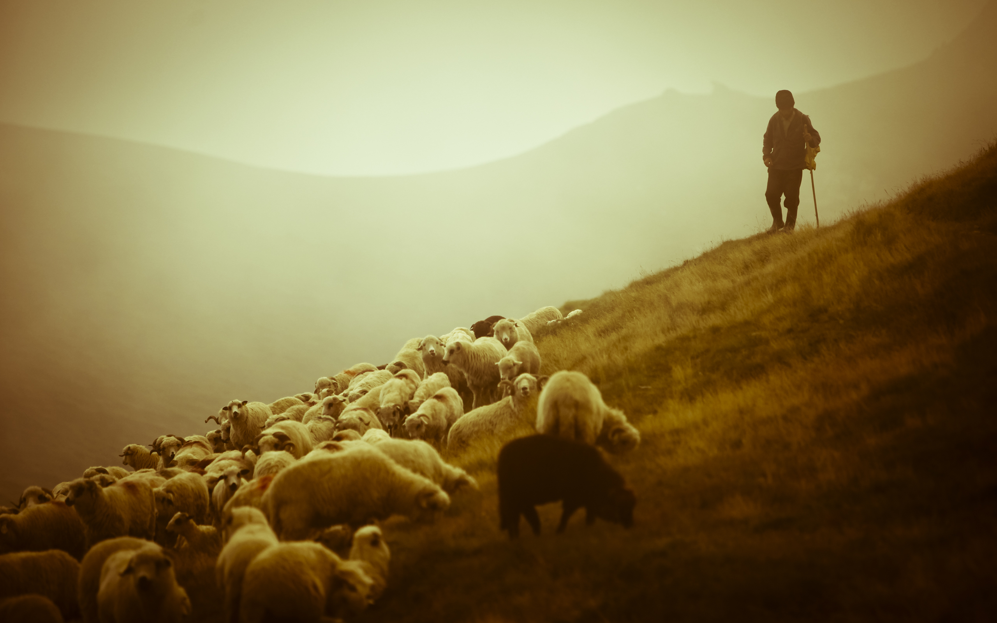
“I will whistle for them and gather them in, for I have redeemed them.”
- Zechariah 10:8
I am the good shepherd. I know my own and my own know me... and they will listen to my voice.
- John 10:14-16
Hope in
the coming
Shepherd

Slide 13
When Judas saw that Jesus was condemned, he changed his mind and brought back the thirty pieces of silver… throwing down the pieces of silver into the temple But the chief priests, taking the pieces of silver, bought with them the potter's field.
- Matthew 27:3-7

Slide 14
That day when nations will “look on me, on him whom they have pierced, they shall mourn for him.
Zechariah 12:10
That day when the fountain of life is opened
Zechariah 13:1
Hope in the coming Kingdom

Slide 15
That day when Jesus returns
“On that day his feet shall stand on the Mount of Olives” - Zechariah 14:4
“Why do you stand looking into heaven? This Jesus, who was taken up from you into heaven, will come in the same way as you saw him go into heaven.” Then they returned to Jerusalem from the mount called Olivet.”
– Acts 1:10-12
Hope in the coming Kingdom

Slide 16
That day when days will end
On that day there shall be no light, cold, or frost. And there shall be a unique day, which is known to the Lord, neither day nor night, but at evening time there shall be light. … And the Lord will be king over all the earth. - Zechariah 14:6-7, 9
Hope in the coming Kingdom

Slide 17
That day of unending worship
Then everyone who survives of all the nations that have come against Jerusalem shall go up year after year to worship the King, the Lord of hosts - Zechariah 14:16
Hope in the coming Kingdom

