Slide 1
together
one

Slide 2
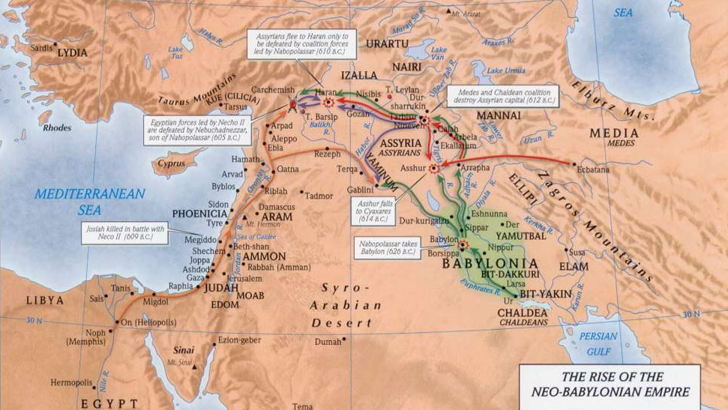
...and the Lord uprooted them from their land in anger and fury and great wrath, and cast them into another land, as they are this day. - Dt. 29:28

Slide 3
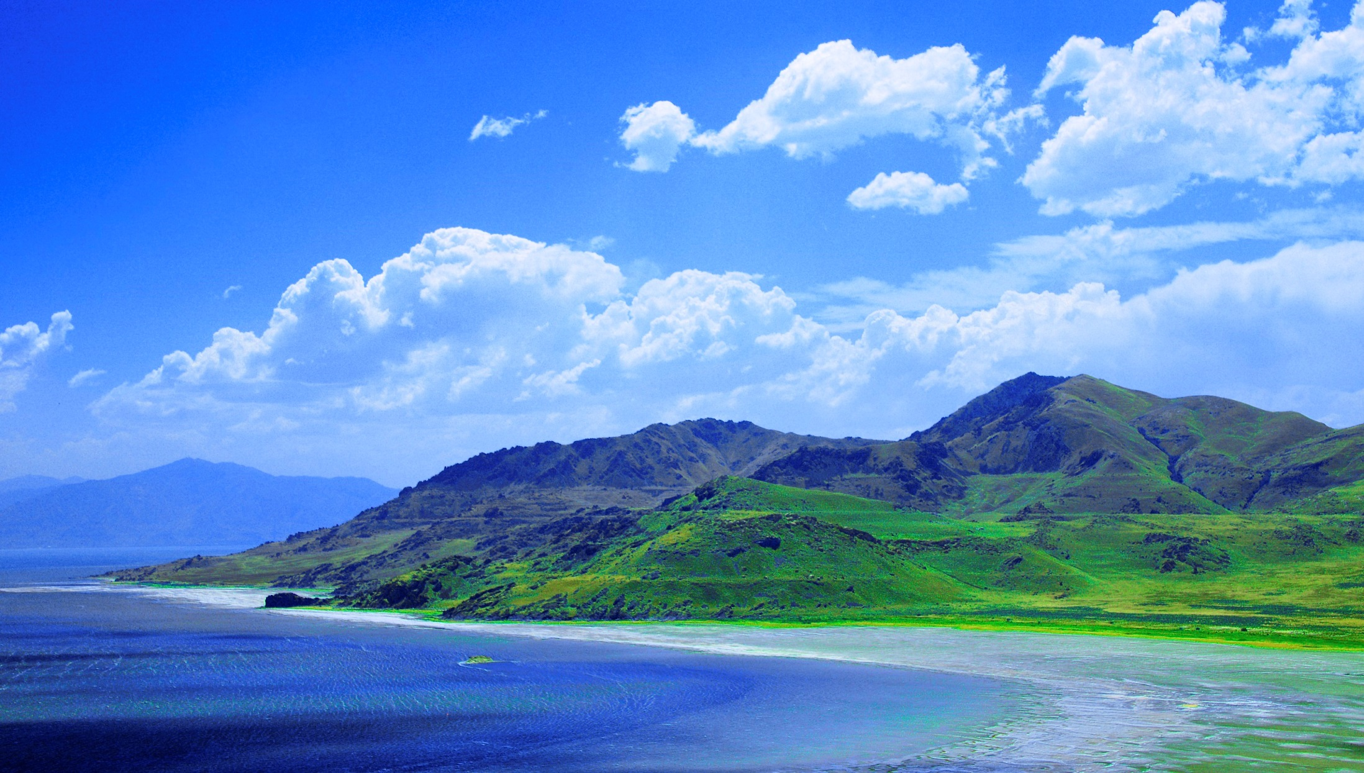
God’s reputation is tied to His people
God scattered His people
God restores His people

Slide 6
ADONAI
BE GATHERED
BE CLEANSED
BE ENABLED
BE PROSPERED

Slide 7
BE GATHERED

Slide 8
P S A L M 1 1 5 : 1
“Not to us, O Lord, not to us,
but to your name give glory,
for the sake of your steadfast love
and your faithfulness!”

Slide 9
BE CLEANSED

Slide 10
1 J O H N 4 : 1 8
“There is no fear in love, but perfect love casts out fear. For fear has to do with punishment, and whoever fears has not been perfected in love.”

Slide 11
BE ENABLED

Slide 12
A C T S 1 : 8
“But you will receive power when the Holy Spirit has come upon you, and you will be my witnesses in Jerusalem and in all Judea and Samaria, and to the end of the earth.”

Slide 13
BE PROSPERED

Slide 14
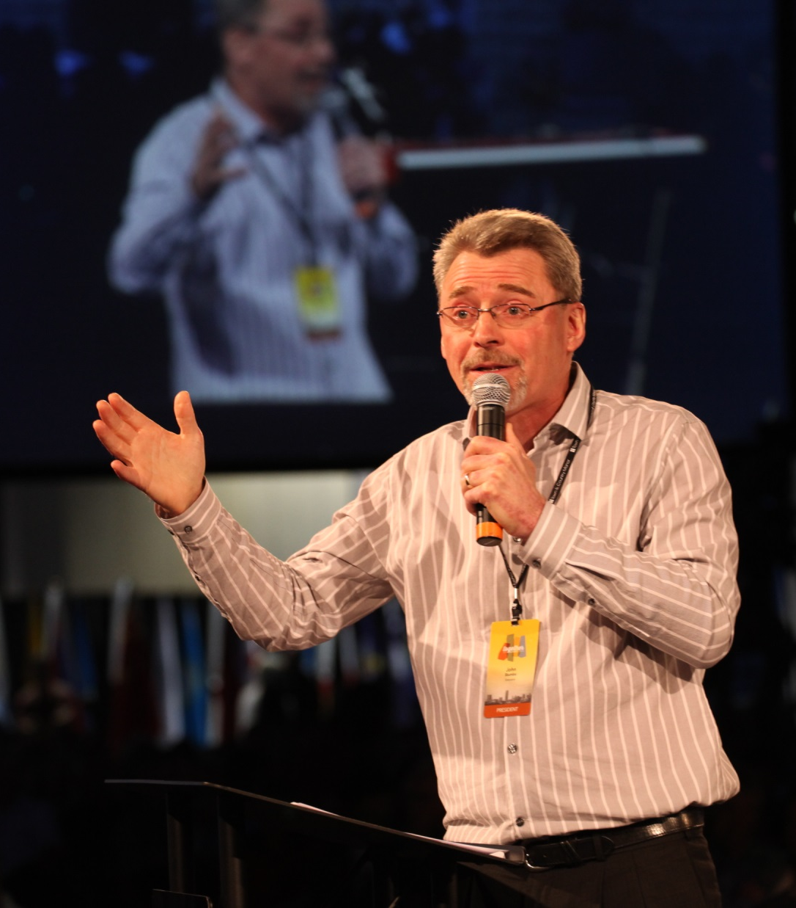
JOHN STUMBO
C&MA President
“I long for Jesus
to live through me because I like
His character
better than my own.”

Slide 15
JOHN STUMBO
C&MA President
“We are the world’s leading provider
of the world’s most lacking resource: Jesus Christ.”

Slide 16
R O M A N S 10 : 13 - 15
For “everyone who calls on the name of the Lord will be saved.”
How then will they call on him in whom they have not believed?
And how are they to believe in him of whom they have never heard?
And how are they to hear without someone preaching?
And how are they to preach unless they are sent?
As it is written, “How beautiful are the feet of
those who preach the good news!”

Slide 17
together
one

